Slide 1
Online Voting System Using C++
Project Presentation

Slide 2
Introduction
• Digital votaing system using C++
• Reduces manual work and errors
• Allows secure voting and result display
• Uses file handling for permanent storage

Slide 3
Abstract
• Console-based online voting application
• User registration and login authentication
• Prevents duplicate voting
• Demonstrates C++ concepts and file handling

Slide 4
Objectives
• Provide secure digital voting
• Store voter and vote details permanently
• Prevent multiple voting
• Display voting results efficiently

Slide 5
• Voter Registration
• User Login Authentication
• Voting Process
• Data Storage using files
• Result Display

Slide 6
Algorithm
1. Start Program
2. Load Voter Data
3. Display Menu
4. Register/Login & Vote
5. Show Results
6. Exit Program

Slide 7
Features
• Secure Login System
• Duplicate Vote Prevention
• Permanent Data Storage
• Result Declaration
• Simple and Easy Interface

Slide 8
Results
• Successful voter registration
• Secure voting process
• Vote counting completed
• Winner displayed correctly

Slide 9
Future Work
• Add MySQL Database
• Password Encryption
• GUI Development
• OTP/Biometric Authentication
• Internet-based Voting

Slide 10
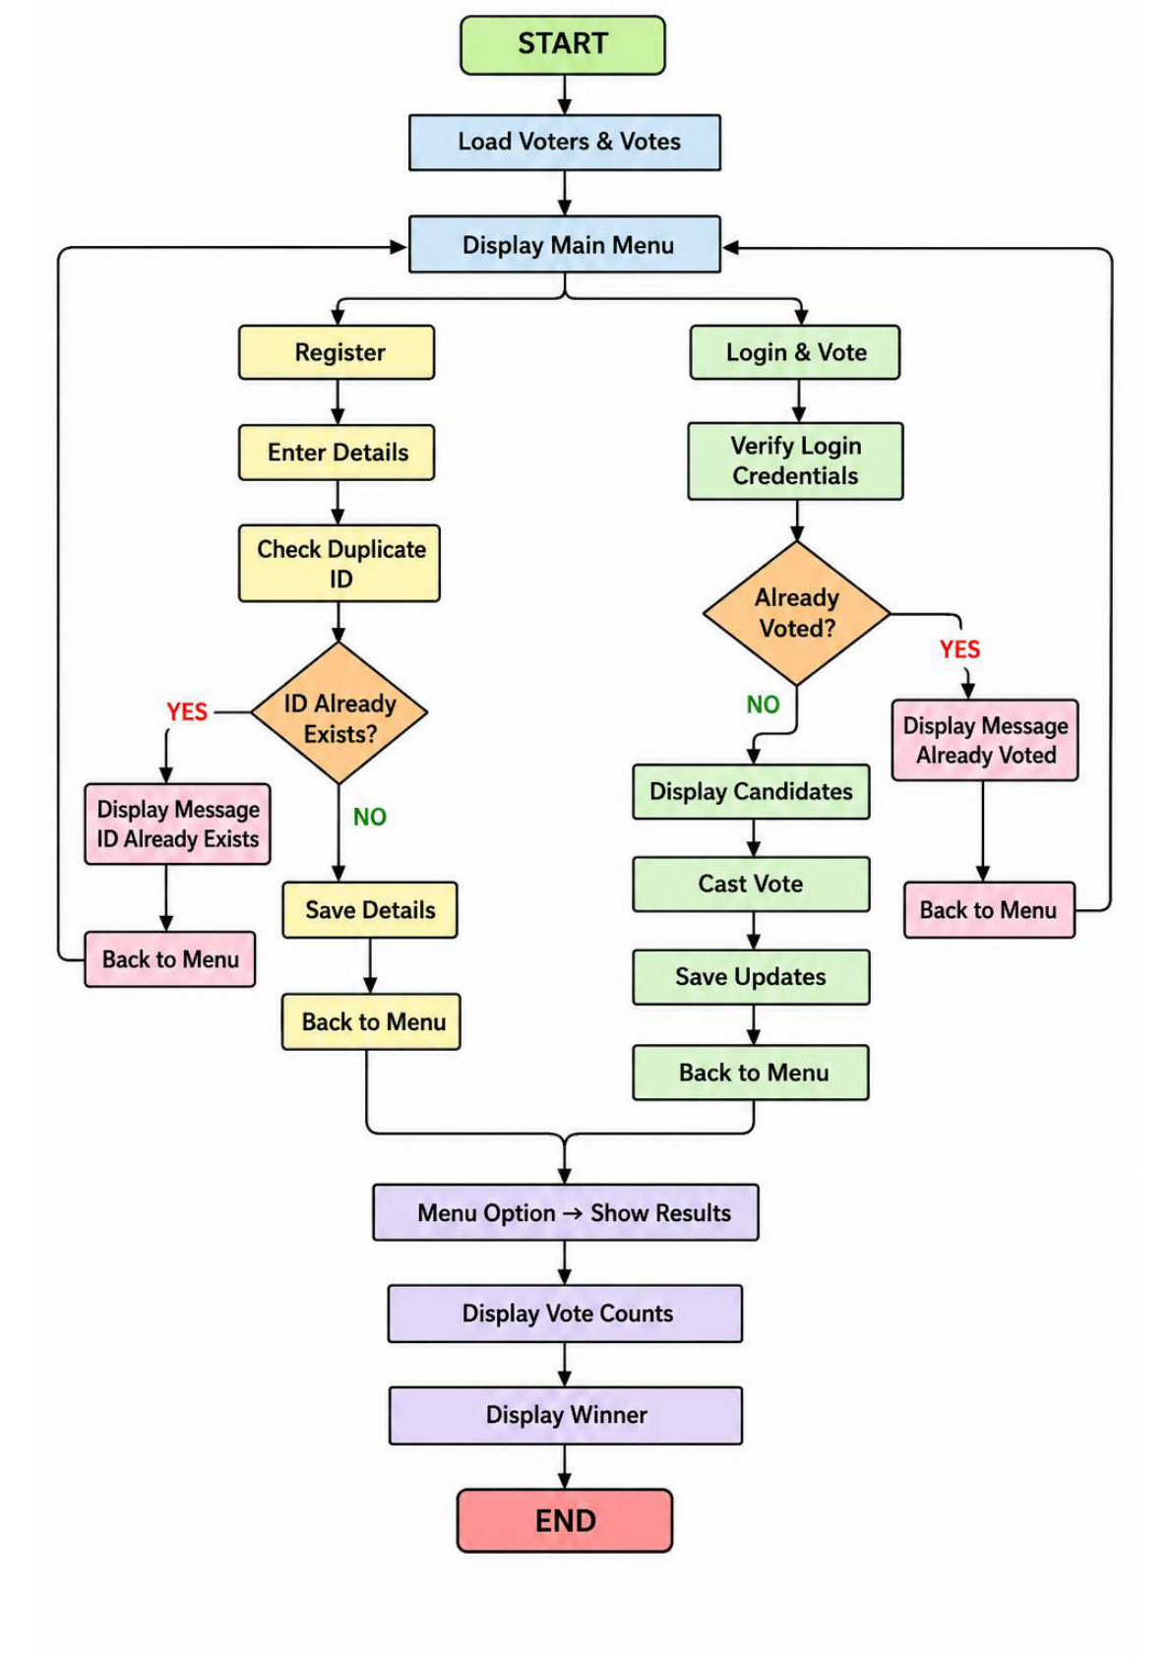
System Flowchart

Slide 11
Conclusion
• Secure and simple voting system
• Demonstrates C++ programming concepts
• Efficient digital election management
• Can be enhanced with advanced features

